Slide 1
UHV-I
Session 5
Fulfilment of Aspirations at the Individual level
Distinguishing between the needs of Self and Body

Slide 2
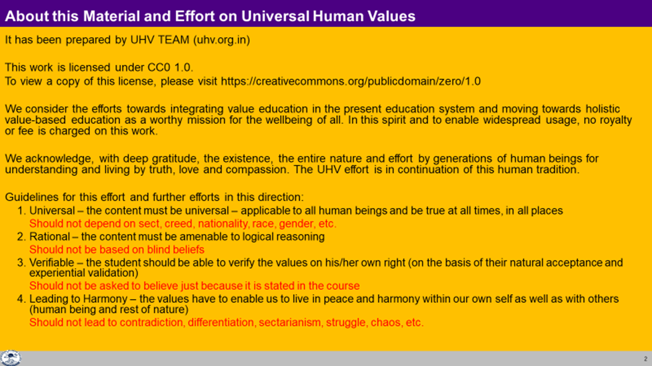

Slide 3
Interaction Before Main Session
Hear from participants about their exploration from previous day(s)
Q&A
Place some expected conclusions, find out if they also came to these/similar conclusions

Slide 4
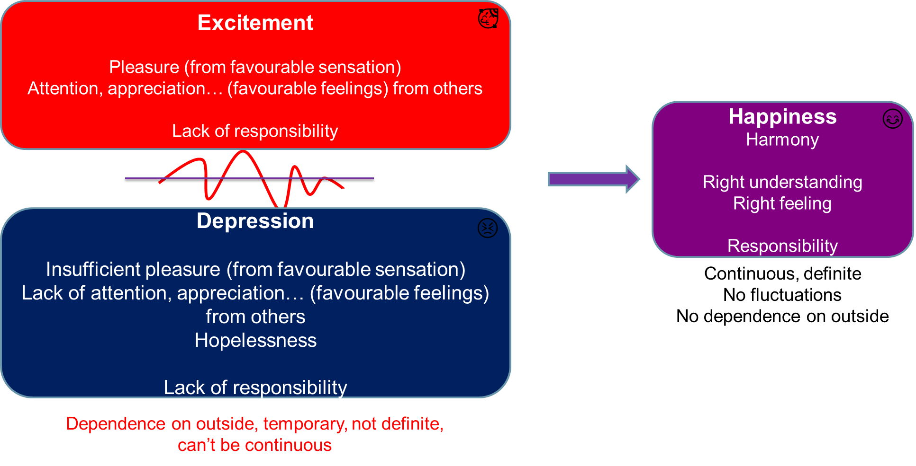
Home Assignment
4.1 List out all the programs you make during a day to make you happy. Find out if the happiness you derived from these programs is definite and continuous, or is it indefinite or short lived. Identify those programs that result in continuous happiness.
4.2 Observe the frequency of the fluctuation (change) of your feelings between excitement and depression (feeling low) during the day. Find out the reason for these fluctuations. Write down your conclusion from this exercise

Slide 5
Home Assignment
4.3 Take your list of aspirations and concerns.
Classify the aspirations into four categories:
  Aspirations at the individual level. e.g., you aspire to be happy within, to be healthy
  Aspirations at the level of family. e.g., you aspire to be comfortable with everyone in your family and you want them to be assured of you
  Aspirations at the level of society. e.g., You aspire for a good job
  Aspirations at the level of nature. e.g., You aspire for natural resources to be readily available
Classify the concerns also into these four categories:
  Concerns at the individual level. e.g., you want to get rid of anger, tension, frustration and peer pressure
  Concerns at the level of family. e.g., you want to overcome the pressure to conform to their norms
  Concerns at the level of society. e.g., you wish that the domination, exploitation, differentiation and terrorism is resolved
  Concerns at the level of nature. e.g., you’d like the pollution levels to reduce
In the next session, we will discuss the aspirations and concerns at the individual level.

Slide 6
UHV-I
Session 5
Fulfilment of Aspirations at the Individual level
Distinguishing between the needs of Self and Body

Slide 7

Understanding Human Being
For fulfilment of our aspirations and resolution of concerns at the Individual level, we need to understand the individual, i.e., human being
When we understand ourselves, we are able to make out our needs clearly
And the definite program to fulfil our needs
Is human being merely the body or something more than that?
When we explore, we will see that there are two realities, the self and the body
Let us try to understand them clearly

Slide 8
Self (I)
मैं
Body
शरीर
Human Being Ekkuo
Co-existence
lgvfLrRo
Who needs food?
Who needs respect?
Who needs clothes?
Who feels happy or sad?
Notes:
Is the self seeing the body or is the body seeing the self?

Slide 9
Human Being Ekkuo | Self (I) eSa | Body “kjhj
Need vko';drk | Happiness (e.g. Respect) lq[k ¼tSls lEeku½ | Physical Facility (e.g. Food) lqfo/kk ¼tSls Hkkstu½
In Time dky esa | Continuous fujUrj | Temporary lkef;d
In Quantity ek=k esa | Qualitative (is Feeling) xq.kkRed ¼Hkko gS½ | Quantitative (Required in Limited Quantity) Ekk=kRed ¼lhfer ek=k esa½
Co-existence
lgvfLrRo
Are these needs of different types or of same type?
Are both types of needs important / Do we want fulfillment of both types of needs?
Are we working to fulfill both types of needs?
What is the priority between the needs of the Self (I) & the needs of the Body?
Notes:
Both are required – food as well as respect
Food but no respect (thali ko dhakka dekar dena)
Respect but no food
Continuous
While going “aisa khana to kabhi kabhi milta hoga”
Voh diwali ki raat ko aapne maara tha…
Bhojan ko continuous bana nahin sakte
Quantity
respect bhav hai – not 1 kg respect
bhojan matratmak hai – 1 kilo bhojan…

Slide 10
Human Being Ekkuo | Self (I) eSa | Body “kjhj
Need vko';drk | Happiness (e.g. Respect) lq[k ¼tSls lEeku½ | Physical Facility (e.g. Food) lqfo/kk ¼tSls Hkkstu½
In Time dky esa | Continuous fujUrj | Temporary lkef;d
In Quantity ek=k esa | Qualitative (is Feeling) xq.kkRed ¼Hkko gS½ | Quantitative (Required in Limited Quantity) Ekk=kRed ¼lhfer ek=k esa½
Fulfilled By iwfrZ ds fy, | Right Understanding & Right Feeling lgh le>] lgh Hkko | Physio-chemical Things HkkSfrd&jklk;fud oLrq
Co-existence
lgvfLrRo
Can you see that
  Both type of needs have to be understood separately
  Both type of needs have to be fulfilled separately
When we mix up the two, we are in trouble!
Notes:
Fulfilled by
Flower to Father – flower is only a symbol. Feeling is primary. Feelings ka bandh mein band kar rakha hai – feelings ka aadan-pradan nahin hota. Feelings ka exchange bhi sukhi hone ka tareeka hai, yeh dhyan mein nahin aaya rahta
One cant fulfill the other
Exclusive dress – attention neq respect. Dress se attention bhar mil paata hai

Slide 11
Check if this happens when we mix up the two
Human Being Ekkuo | Self (I) eSa | = | Body “kjhj
Need vko’;drk | Respect lEeku | = | Physical Facility (Eg. Food, Clothes) lqfo/kk (tSls&Hkkstu] diM+k)
 | Continuous fujUrj | = | Unlimited vlhfer
Feeling of Deprivation
I don’t have enough!
Accumulation = unlimited?
Effort for Physical Facility
by any means?
Accumulation of Physical Facility – Unlimited!
Lqfo/kk laxzg & vlhfer!
Loop
Check if you
are caught up
In this loop
Deprivation
nfjnzrk

Slide 12

Understanding the Self
Natural Acceptance
To be happy
To be prosperous
To have the feeling of relationship
Dialogue?
Self
Imagination
I feel like taking revenge…
I desire to be a billionaire…
I think I am special…
I expect to be respected…
Co-existence
Body
Behaviour O;ogkj
Work dk;Z
Notes:
The Self can be recognized in terms of its activity
We can see the activity of imagination… try it now – what is going on? All the time or only sometimes (keep it open)?
Reinforce - Behaviour and work are only expressions of imagination
Every Self has a natural acceptance
(E.g., We have a natural acceptance for the feeling of relationship… not for opposition)
The natural acceptance is a glimpse of the higher possibility in the Self, a glimpse of what I really want to be
Natural acceptance is definite, uncorrupted, universal…
5. The dialog that we started between me and you will soon begin within you – a dialogue beween your imagination and your natural acceptance

Slide 13
Dialogue Within
Natural Acceptance for
Feeling of Relationship
My basic aspiration is here
My Desired State
My Intention
Natural Acceptance
Contradiction
Unhappiness
Harmony
Happiness
Dialogue?
Guiding?
All my aspirations and concerns are here
My Current State
My Competence
Imagination
Feeling of
Opposition
Feeling of
Relationship
Notes:
The dialogue within is the dialogue between my imagination and my natural acceptance
Between my competence and my intention
Between “what I am” and “what I really want to be”
The natural acceptance is always for relationship
My imagination may or may not always be for relationship! Sometimes it is for opposition!
Now whenever my imagination is in harmony with my natural acceptance, I am in a state of happiness!
Whenever my imagination is in contradiction with my natural acceptance, I am in a state of unhappiness!
So to be in harmony, all I have to do is to
Be aware of my natural acceptance
Be aware of my imagination
Ensure the dialogue and ensure that my imagination is in line with my natural acceptance

Slide 14
Harmony in the Self
This part is definite, un-corrupted, pure, innate in every Self!
We may or may not be aware of it
We have the potential to be aware of it, and to take guidance from it!
INTENTION
What I really
want to be
Desired State
Natural Acceptance
Dialogue?
Guiding?
Our feeling, imagination may keep fluctuating
When our feeling, imagination is guided by our Natural Acceptance, we are in harmony within… we are happy!
COMPETENCE
What I am
Current State
Imagination
Notes:
The dialogue within is the dialogue between my imagination and my natural acceptance
Between my competence and my intention
Between “what I am” and “what I really want to be”
The natural acceptance is always for relationship
My imagination may or may not always be for relationship! Sometimes it is for opposition!
Now whenever my imagination is in harmony with my natural acceptance, I am in a state of happiness!
Whenever my imagination is in contradiction with my natural acceptance, I am in a state of unhappiness!
So to be in harmony, all I have to do is to
Be aware of my natural acceptance
Be aware of my imagination
Ensure the dialogue and ensure that my imagination is in line with my natural acceptance

Slide 15
Sum Up
Human being is the co-existence of the Self and the Body
Every Self is endowed with the faculty of “Natural Acceptance”
The Body needs physical facility – this need is temporary (required from time to time)
It is fulfilled by physio chemical things from rest of nature
Happiness is the need of the Self (i.e., my basic aspiration) – It is required all the time
It is fulfilled by right understanding and right feeling in the Self
(It can not be fulfilled by physical facility; it can not be fulfilled in continuity by getting feelings from others; if we assume the human being to be the Body, we get caught in a loop of trying to get continuous happiness from outside and keep on accumulating physical facility)
There is imagination going on in the Self. When the imagination is in line with the natural acceptance, the Self is in harmony, happiness
In UHV-II, we will discuss this in more detail!

Slide 16
Home Assignment

Slide 17
Home Assignment
5.1. Could you see that you have two types of needs:
  A continuous need (like the need for respect) – need of the Self
  A temporary need, which is required from time to time (like the need for food) – need of the Body
5.2. Look into your list of aspirations. Classify it into 2 categories – aspirations related to the Body (like food) and aspirations related to the Self (like name and fame). Which aspirations are prominent – aspirations related to the Self or aspirations related to the Body? Reflect on how you are trying to fulfil the needs related to the Self. What is your takeaway from this exploration?
5.3. Can you see you have an inherent faculty of natural acceptance? Is it always for harmony, for relationship?
5.4. Can you see that something is going on in your imagination? Can you see that when you have a feeling that is naturally acceptable to you, you are in harmony, happy?
5.5. Is the program for fulfilment of your aspirations and resolution of your concerns at the individual level clearer through this exploration? Discuss the program with your batchmates

Slide 18
Questions?

Slide 19
Related to Need of the Self Related to Need of Body
RIGHT UNDERSTANDING
(le>)
in the self
1
Both needs must be satisfied for human-being to be fulfilled
2
RELATIONSHIP (laca/k)
with human beings
3
PHYSICAL FACILITY
(lqfo/kk)
with rest of nature
Feelings
- Trust
- Respect
- …
MUTUAL HAPPINESS
(mHk; lq[k)
MUTUAL PROSPERITY
(mHk; le`f))

